Slide 1
CHAPTER 5 MULTIPROCESSOR SYSTEMS
PARALLEL PROGRAMMING MODELS
MESSAGE-PASSING SYSTEMS
SHARED-MEMORY ARCHITECTURES
COHERENCE PROTOCOLS—BUS SNOOPING
COHERENCE PROTOCOLS—DIRECTORIES: CC-NUMA

Slide 2
PARALLEL PROGRAMMING MODELS
HOW PARALLEL COMPUTATIONS CAN BE EXPRESSED IN A HIGH-LEVEL LANGUAGE
SIMPLE EXTENSIONS THROUGH AN API (APPLICATION-PROGRAMMING INTERFACE) OF COMMON PROGRAMMING LAGUAGES SUCH AS C/C++ OR FORTRAN
SHARED-MEMORY: OPEN-MP OR PTHREADS
MESSAGE-PASSING: MPI (MESSAGE-PASSING INTERFACE)
PARALLELIZING COMPILERS TRANSLATE A SEQUENTIAL PROGRAM INTO PARALLEL THREADS
THREADS OR PROCESSES MUST COMMUNICATE AND COORDINATE THEIR ACTIVITY (SYNCHRONIZATION)
CONSIDER TWO PROGRAM SEGMENTS S1 AND S2 SO THAT S1 PRECEDES S2 IN THE SEQUENTIAL CODE
TO RUN IN PARALLEL S1 MUST AVOID WRITING INTO VARIABLES THAT ARE INPUT TO S2 (RAW HAZARD)
AND, S2 MUST AVOID WRITING INTO VARIABLES THAT ARE WRITTEN OR READ BY S1 (WAW AND WAR HAZARDS)
TO CONFORM TO SEQUENTIAL SEMANTICS

Slide 3
DATA vs FUNCTION PARALLELISM
DATA PARALLELISM:
PARTITION THE DATA SET
APPLY THE SAME FUNCTION TO EACH PARTITION
SPMD (SINGLE PROGRAM MULTIPLE DATA)
(NOT SIMD)
MASSIVE PARALLELISM
FUNCTION PARALLELISM
INDEPENDENT FUNCTIONS ARE EXECUTED ON DIFFERENT PROCESSORS
E.G.: STREAMING--SOFTWARE PIPELINE
MORE COMPLEX, LIMITED PARALLELISM
COMBINE BOTH: FUNCTION + DATA PARALLELISM

Slide 4
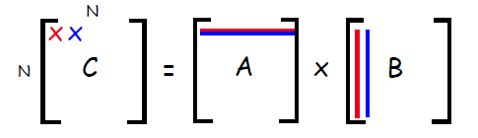
EXAMPLE: MATRIX MULTIPLY + SUM
SEQUENTIAL PROGRAM:
1 sum = 0;
2 for (i=0,i<N, i++)
3 for (j=0,j<N, j++){
4 C[i,j] = 0;
5 for (k=0,k<N, k++)
6 C[i,j] = C[i,j] + A[i,k]*B[k,j];
7 sum += C[i,j];
8 }
MULTIPLY MATRICES A[N,N] BY B[N,N] AND STORE RESULT IN C[N,N]
ADD ALL ELEMENTS OF C

Slide 5
INTER-PE COMMUNICATION
IMPLICITELY VIA MEMORY
PROCESSORS SHARE SOME MEMORY
COMMUNICATION IS IMPLICIT THROUGH LOADS AND STORES
NEED TO SYNCHRONIZE
NEED TO KNOW HOW THE HARDWARE INTERLEAVES ACCESSES FROM DIFFERENT PROCESSORS
EXPLICITELY VIA MESSAGES (SENDS AND RECEIVES)
NEED TO KNOW THE DESTINATION AND WHAT TO SEND
EXPLICIT MESSAGE-PASSING STATEMENTS IN THE CODE
CALLED “MESSAGE PASSING”
NO HYPOTHESIS ON THE RELATIVE SPEED OF PROCESSORS

Slide 6
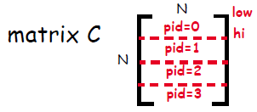
EXAMPLE: MATRIX MULTIPLY + SUM
SHARED-MEMORY PROGRAM
/* A, B, C, BAR, LV and sum are shared
/* All other variables are private
1a low = pid*N/nproc; /pid=0...nproc-1
1b hi = low + N/nproc; /rows of A
1c mysum = 0; sum = 0; /A and B are in
2 for (i=low,i<hi, i++) /shared memory
3 for (j=0,j<N, j++){
4 C[i,j] = 0;
5 for (k=0,k<N, k++)
6 C[i,j] = C[i,j] + A[i,k]*B[k,j]; /at the end matrix C is
7 mysum +=C[i,j]; /C is in shared memory
8 }
9 BARRIER(BAR);
10 LOCK(LV);
sum += mysum;
UNLOCK(LV);

Slide 7
MUTUAL EXCLUSION
Need for “Mutual Exclusion”
Assume the following statements are executed by 2 threads, T1 and T2, on Sum
T1 T2
Sum<- Sum+1 Sum<- Sum+1
The programmer’s expectation is that, whatever the order of execution of the two statements is, the final result will be that Sum is incremented by 2
However program statements are not executed in an atomic fashion.
Compiled code on a RISC machine includes several instructions
A possible interleaving of execution is:
T1 T2
r1 <- Sum
r1 <- Sum
r1 <- r1 + 1
r1 <- r1 + 1
Sum <- r1
Sum <- r1
At the end the result is that Sum is incremented by 1 (NOT 2)

Slide 8
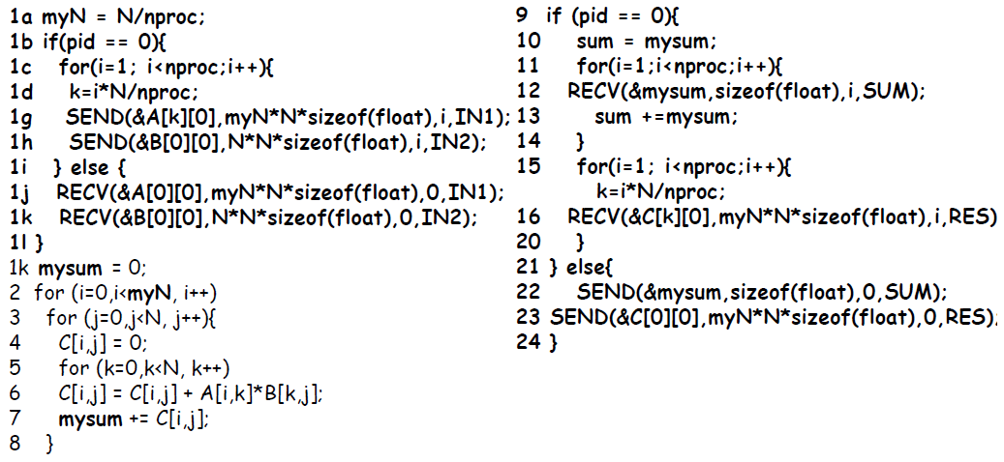
EXAMPLE: MATRIX MULTIPLY + SUM
MESSAGE-PASSING PROGRAM

Slide 9
MESSAGE-PASSING: MULTICOMPUTERS
PROCESSING NODES INTERCONNECTED BY A NETWORK
COMMUNICATION CARRIED OUT BY MESSAGE EXCHANGES
SCALES WELL
HARDWARE IS INEXPENSIVE
SOFTWARE IS COMPLEX

Slide 10
SYNCHRONOUS MESSAGE-PASSING
CODE FOR THREAD T1: CODE FOR THREAD T2:
A = 10; B = 5;
SEND(&A,sizeof(A),T2,SEND_A); RECV(&B,sizeof(B),T1,SEND_A);
A = A+1; B=B+1;
RECV(&C,sizeof(C),T2,SEND_B); SEND(&B,sizeof(B),T1,SEND_B);
printf(C);
EACH SEND/RECV HAS 4 OPERANDS:
STARTING ADDRESS IN MEMORY
SIZE OF MESSAGE
DESTINATION/SOURCE THREAD ID
TAG CONNECTING SENDS AND RECEIVES
IN SYNCHRONOUS M-P SENDER BLOCKS UNTIL RECV IS COMPLETED AND RECEIVER BLOCKS UNTIL MESSAGE HAS BEEN SENT
NOTE: THIS IS MUCH MORE THAN WAITING FOR MESSAGE PROPAGATION
QUESTION: WHAT IS THE VALUE PRINTED UNDER SYNCHRONOUS M-P?
VALUE 10 IS RECEIVED IN B BY T2; B IS INCREMENTED BY 1
THEN THE NEW VALUE OF B (11) IS SENT AND RECEIVED BY T1 INTO C
AND THREAD 1 PRINTS “11”

Slide 11
SYNCHRONOUS MESSAGE-PASSING
ADVANTAGE: ENFORCES SYNCHRONIZATION
DISADVANTAGES:
PRONE TO DEADLOCK
BLOCK THREADS (NO OVERLAP OF COMMUNICATION WITH COMPUTATION)
DEADLOCK EXAMPLE:
CODE FOR THREAD T1: CODE FOR THREAD T2:
A = 10; B = 5;
SEND(&A,sizeof(A),T2,SEND_A); SEND(&B,sizeof(B),T1,SEND_B)
RECV(&C,sizeof(C),T2,SEND_B); RECV(&D,sizeof(D),T1,SEND_A);
TO ELIMINATE THE DEADLOCK: SWAP THE SEND/RECV PAIR IN T2
OR EMPLOY ASYNCHRONOUS MESSAGE-PASSING

Slide 12
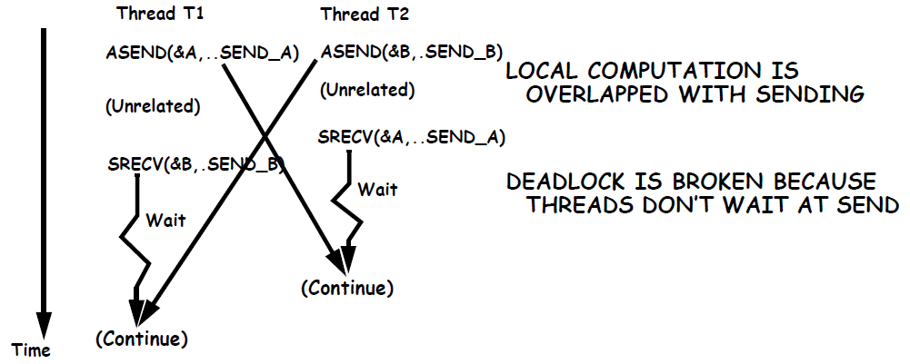
SYNCHRONOUS MESSAGE-PASSING
CODE FOR THREAD T1: CODE FOR THREAD T2:
A = 10; B = 5;
ASEND(&A,sizeof(A),T2,SEND_A); ASEND(&B,sizeof(B),T1,SEND_B);
<Unrelated computation;> <Unrelated computation;>
SRECV(&B,sizeof(B),T2,SEND_B); SRECV(&A,sizeof(B),T1,SEND_A);
BLOCKING vs NON-BLOCKING MESSAGE PASSING
BLOCKING: RESUME ONLY WHEN AREA OF MEMORY CAN BE MODIFIED
NON-BLOCKING: RESUME EARLY--RELIES ON PROBE MESSAGES

Slide 13
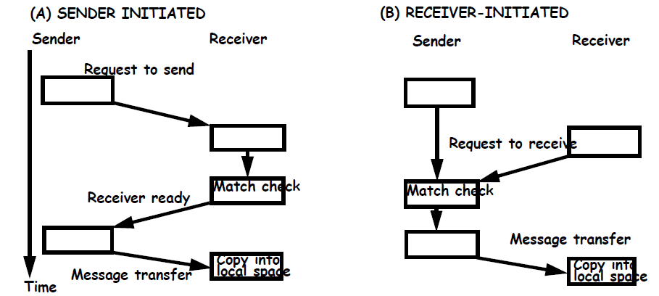
SYNCHRONOUS MESSAGE-PASSING
IN GENERAL MULTIPLE THREADS ARE RUNNING ON A CORE
THIS HANDSHAKE IS FOR SYNCHRONOUS M-P
CAN BE APPLIED TO BLOCKING OR NON-BLOCKING ASYNCHRONOUS
SENDER CONTINUES AFTER SEND (A) AND RECVer AFTER RECV (B)
IF BLOCKING, SENDER MUST MAKE A COPY OF MESSAGE FIRST

Slide 14
SUPPORT FOR MESSAGE PASSING PROTOCOLS
DATA MUST BE COPIED FROM/TO MEMORY TO/FROM NI
PROCESSOR COULD DO IT
DMA (DIRECT MEMORY ACCESS) CAN SPEED UP MESSAGE TRANSFERS AND OFF-LOAD THE PROCESSOR
DMA IS PROGRAMMED BY THE PROCESSOR;
START ADDRESS AND SIZE
DEDICATED MESSAGE PROCESSORS
USE A SPECIAL PROCESSOR TO PROCESS MESSAGES ON BOTH ENDS
THUS RELIEVING THE COMPUTE O/S FROM DOING IT
SUPPORT FOR USER-LEVEL MESSAGES
BASIC MESSAGE PASSING SYSTEMS DRIVE DMA ENGINE FROM O/S
THIS IS NEEDED FOR PROTECTION BETWEEN USERS
MESSAGE IS FIRST COPIED INTO SYSTEM SPACE AND THEN INTO USER SPACE (RECEIVE)
MESSAGE IS COPIED FROM USER SPACE TO SYSTEM SPACE (SEND)
TAG USER MESSAGES SO THAT THEY ARE PICKED UP AND DELIVERED DIRECTLY IN USER MEMORY SPACE (ZERO COPY)

Slide 15
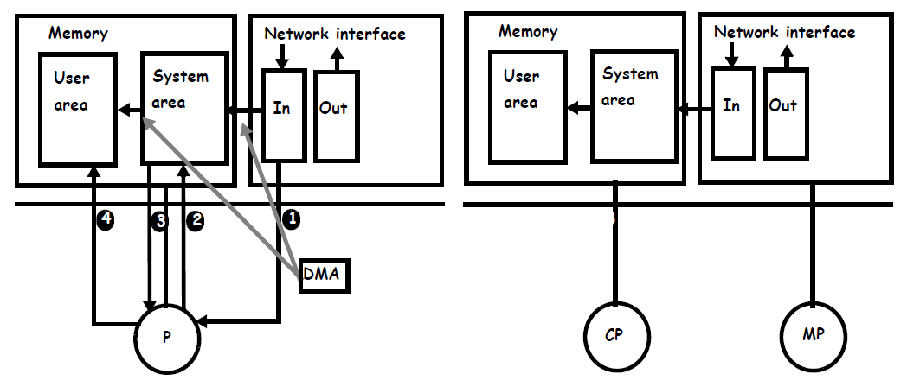
MESSAGE-PASSING SUPPORT

Slide 16
BUS-BASED SHARED MEMORY SYSTEMS
MULTIPROCESSOR CACHE ORGANIZATIONS
SNOOPY CACHE PROTOCOLS
A SIMPLE SNOOPY CACHE PROTOCOL
DESIGN SPACE OF SNOOPY CACHE PROTOCOLS
PROTOCOL VARIATIONS
MULTI-PHASE CACHE PROTOCOLS
CLASSIFICATION OF COMMUNICATION EVENTS
TRANSLATION LOOKASIDE BUFFER (TLB) CONSISTENCY

Slide 17
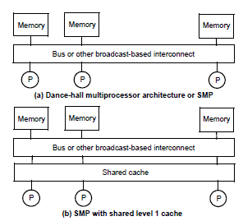
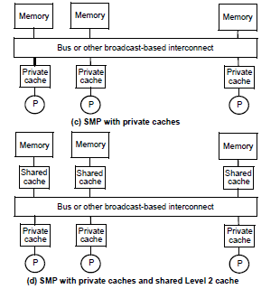
CACHE ORGANIZATIONS
(a) CONCEPTUAL – NOT PRACTICAL; NO CACHE
(b) SHARED L1 CACHE; NO REPLICATION BUT HIGHER HIT LATENCY THAN IN (c)
(c) PRIVATE L1 CACHES
(d) PRIVATE L1 CACHES AND SHARED L2; POPULAR FOR CHIP MULTIPROCESSORS (CMPS)
REST OF DISCUSSION CONSIDERS ORGANIZATION (c) AND (d)

Slide 18
COHERENCE
IN UNIPROCESSORS, A LOAD MUST RETURN THE VALUE OF THE LATEST STORE IN PROCESS ORDER WITH THE SAME ADDRESS
THIS IS DONE THROUGH MEMORY DISAMBIGUATION AND MANAGMENT OF CACHE HIERARCHY
SOME PROBLEMS WITH I/O, AS I/O IS OFTEN CONNECTED TO MEMORY BUS
COHERENCE BETWEEN I/O TRAFFIC AND CACHE MUST BE ENFORCED
HOWEVER, THIS IS INFREQUENT AND SOFTWARE IS INFORMED
SO SOFTWARE SOLUTIONS WORK
UNCACHEABLE MEMORY, UNCACHEABLE OPS, CACHE FLUSHING
ANOTHER SOLUTION IS TO PASS I/O THROUGH CACHE
IN MULTIPROCESSORS THE COHERENCE PROBLEM IS PERVASIVE, PERFORMANCE CRITICAL AND SOFTWARE IS NOT INFORMED
SHARING OF DATA, THREAD MIGRATION AND I/O
COMMUNICATION IS IMPLICIT
THUS HARDWARE MUST SOLVE THE PROBLEM.

Slide 19
SNOOPING-BASED CACHE COHERENCE
BASIC IDEA
TRANSACTIONS ON THE BUS ARE “VISIBLE” TO ALL PROCESSORS
BUS INTERFACE CAN “SNOOP” (MONITOR) THE BUS TRAFFIC AND TAKE ACTION WHEN REQUIRED
TO TAKE ACTION THE “SNOOPER” MUST CHECK THE STATUS OF THE CACHE
DUAL DIRECTORY
SNOOPING CAN BE DONE IN THE 2ND LEVEL CACHE
SINCE THERE IS INCLUSION, SLC FILTERS OUT TRANSACTIONS TO FLC
SLC CONTAINS A BIT INDICATING WHETHER THE BLOCK IS IN FLC

Slide 20
A SIMPLE PROTOCOL FOR WRITE-THROUGH CACHES
TO SIMPLIFY ASSUME NO ALLOCATE ON STORE MISSES
ALL STOREs AND LOAD MISSES PROPAGATE ON THE BUS
STOREs MAY UPDATE OR INVALIDATE CACHES
STATE DIAGRAM
EACH CACHE IS REPRESENTED BY A FINITE STATE MACHINE
IMAGINE P IDENTICAL FSMs WORKING TOGETHER, ONE PER CACHE
FSM REPRESENTS THE BEHAVIOR OF A CACHE W.R.T. A MEMORY BLOCK
NOT THE CACHE CONTROLLER
NO NEW STATE (1 BIT PER BLOCK IN CACHE)

Slide 21
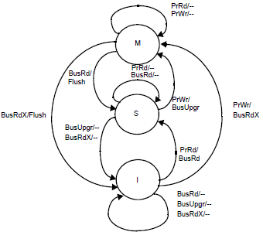
WRITE-BACK: MSI INVALIDATE PROTOCOL
BLOCK STATES:
Invalid (I);
Shared (S): one copy or more,
memory is clean;
Dirty (D) or Modified (M): one copy,
memory is stale
PROCESSOR REQUESTS
PrRd or PrWr
BUS TRANSACTIONS
BusRd: requests copy
with no intent to modify
BusRdX: requests copy
with intent to modify
BusUpgr: invalidate remote
copies
WRITE TO SHARED BLOCK: USE BusUpgr
FLUSH: FORWARD BLOCK COPY TO REQUESTER (MEMORY COPY IS STALE)
MEMORY SHOULD BE UPDATED AT THE SAME TIME

Slide 22
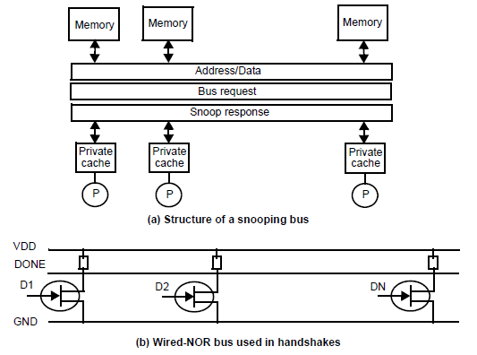
MSI: HARDWARE STRUCTURES
A BUS TRANSACTION INVOLVES TRANSMITTING A BUS REQUEST ALONG WITH THE ADDRESS
IN RESPONSE, THERE IS A SNOOP REPLY
CAN BE ASYNCHRONOUS; USE OF HANDSHAKE ARRANGEMENT IN b)
CAN BE SYNCHRONOUS; MUST KEEP SNOOP RESPONSE LATENCY SHORT; USE OF DUAL DIRECTORIES

Slide 23
MESI PROTOCOL
PROBLEM WITH MSI INVALIDATE PROTOCOL
MOST OF BLOCKS ARE PRIVATE--NOT SHARED
READ MISS FOLLOWED BY WRITE CAUSES TWO BUS ACCESSES
ADD AN EXCLUSIVE STATE
Exclusive (E): one copy, memory is clean
use a Shared (S) line on bus to detect that the copy is unique
On a read miss go to E or S depending on the value returned by the Shared line.
Could use BusUpgr in transition from S to M

Slide 24
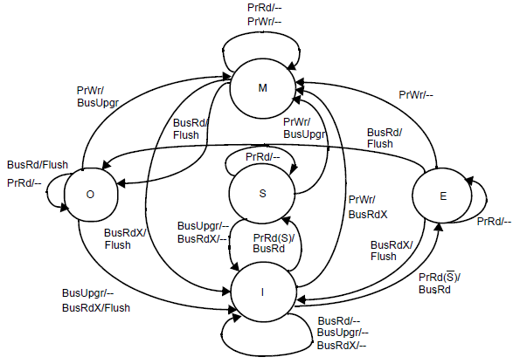
MOESI: A GENERAL CLASS OF PROTOCOLS
MOESI CAN MODEL (AMONG OTHERS) MSI AND MESI
ADDS NOTION OF OWNERSHIP TO AVOID UPDATING MEMORY ON EVERY WRITE; OWNER EVENTUALLY UPDATES MEMORY
ALLOWS CACHE-TO-CACHE TRANSFERS BETWEEN OWNER AND REQUESTER
OWNERSHIP IS TRANSFERRED TO ANOTHER CACHE OR TO MEMORY WHEN BLOCK IS INVALIDATED/REPLACED

Slide 25
CACHE PROTOCOL OPTIMIZATIONS
PRODUCER-CONSUMER SHARING; E.G. ONE PROCESSOR WRITES AND OTHERS (SAY N PROC.) READ THE SAME DATA
RESULTS IN INVALIDATION FOLLOWED BY N READ MISSES
CAN DO BETTER BY LETTING ONE READ MISS BRING BLOCK INTO ALL N CACHES – READ SNARFING (OR READ BROADCAST).
MIGRATORY SHARING; PROCESSORS READ AND MODIFY SAME CACHE BLOCK – ONE AT A TIME
COMMON BEHAVIOR IN DATA ACCESS INSIDE CRITICAL SECTIONS
RESULTS IN ONE COHERENCE MISS FOLLOWED BY AN INVALIDATION; THE INVALIDATION COULD BE SAVED.
OPTIMIZATION: ISSUE ONLY READ-EXCLUSIVE (COMBINED READ AND UPGRADE)
NEEDS SOME (SLIGHT) MODIFICATIONS TO A M(OE)SI PROTOCOL
UPDATE-BASED PROTOCOLS: UPDATE (INSTEAD OF INVALIDATE) BLOCK COPIES
IF EVERY WRITTEN VALUE IS CONSUMED, UPDATE PROTOCOLS WILL OUTPERFORM INVALIDATE-BASED PROTOCOLS (SHORTER LATENCY AND LESS BANDWIDTH)

Slide 26
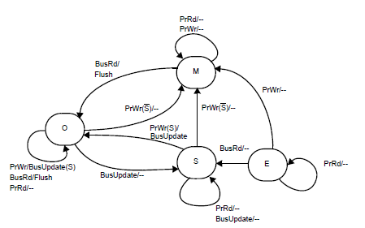
WRITE-BACK: MSI UPDATE PROTOCOL
BLOCK STATES:
Invalid (I);
Shared (S): multiple copies, memory is clean;
Dirty (D) or Modified (M): one copy, memory is stale
PROCESSOR REQUESTS
PrRd or Pr Wr
BUS TRANSACTIONS
BusRd: requests copy
BusUpdate: update remote copies
SHARED BUS LINE (S): INDICATES WHETHER REMOTE COPIES EXIST

Slide 27
TRADEOFF ANALYSIS: INVALIDATE vs UPDATE
WRITE-RUN OF AN ACCESS SEQUENCE TO THE SAME BLOCK: THE NUMBER OF WRITES IN A ROW BY A PROCESSOR BEFORE A READ OR WRITE IS ENCOUNTERED BY ANOTHER PROCESSOR
Q: WHAT IS THE LENGTH OF THE WRITE RUN IN THE FOLLOWING SEQUENCE?
R1, W1, R1, W1, W2, R2,..
A: TWO BECAUSE AFTER THE 2ND WRITE BY P1, P2 WRITES
BANDWIDTH TRADEOFF (INVALIDATE vs UPDATE):
WRITE-RUN OF LENGTH N
INVALIDATE: BANDWITH = B(UPGRADE) + B(READ MISS)
UPDATE: BANDWIDTH = N X B(UPDATE)
ASSUME: B(UPGRADE) = B(UPDATE)
UPDATE OUTPERFORMS INVALIDATE WHEN
N < 1 + B(READ MISS)/B(UPDATE)

Slide 28
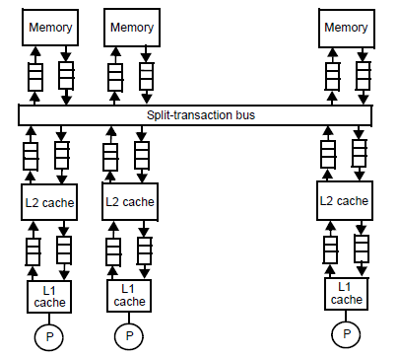
MULTIPHASE CACHE PROTOCOLS
MACHINE MODELS SO FAR HAVE ASSUMED
SINGLE LEVEL OF PRIVATE CACHES
“ATOMIC” (NON-PIPELINED) BUSES
A REALISTIC MODEL COMPRISES
A MULTI-LEVEL (PRIVATE) CACHE HIERARCHY
A SPLIT-TRANSACTION (PIPELINED) BUS

Slide 29
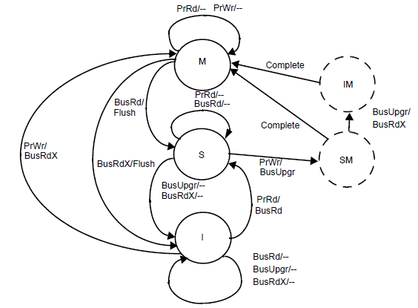
TRANSIENT (NON-ATOMIC) CACHE STATES
USING ‘STABLE’ STATES (E.G. M S I) AS AN ABSTRACTION IS TOO HIGH-LEVEL TO RESOLVE RACES IN CACHE PROTOCOLS
EXAMPLE)
Q: TWO PROCESSORS ISSUE A BUS UPGRADE TO A BLOCK IN STATE SHARED. WHEN IS THE RACE RESOLVED?
A: AFTER BUS ARBITRATION
TRANSIENT STATES DEAL WITH RACE CONDITIONS THAT RESULT FROM E.G. RESOURCE ARBITRATION:
TRANSIENT STATES

Slide 30
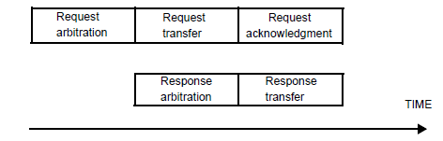
SPLIT-TRANSACTION BUS
SPLIT-TRANSACTION BUS: PIPELINES A SEQUENCE OF PHASES IN A BUS TRANSACTION; E.G. ARBITRATION, TRANSFER, RESPONSE
MUST DIVIDE TRANSACTION INTO SUBTRANSACTIONS: ADDS ADDITIONAL LATENCY; E.G. FOR BUS ARBITRATION:
TRADEOFFS LATENCY VS BANDWIDTH
MUST BALANCE PIPELINE STAGES TO MAXIMIZE THROUGHPUT
SEPARATION BETWEEN REQUEST/RESPONSE ARBITRATION

Slide 31
ACCESS RACES ON SPLIT-TRANSACTION BUSES
MUST DEAL WITH
MULTIPLE REQUESTS TO SAME ADDRESS
REPORTING SNOOP RESULTS
BUFFER OVERFLOWS
USE CONCEPT OF TRANSIENT STATES
MULTIPLE REQUESTS TO SAME ADDRESS:
ALLOW ONLY ONE REQUEST TO SAME ADDRESS AT A TIME
USE ‘REQUEST TABLE’ MONITORED BY ALL NODES
EARLY REPORT OF SNOOP RESULTS
CACHE DIR. LOOKUP BEFORE BUFFERING IS ESSENTIAL
BUFFER OVERFLOW PREVENTION
ADD PROVISIONS IN PROTOCOL TO ‘NACK’ WHEN BUFFERS OVERFLOW

Slide 32
MULTI-LEVEL CACHE ISSUES
ADDING ANOTHER LEVEL OF PRIVATE CACHE OFFERS SOME BENEFITS
SHORTER MISS PENALTY TO NEXT LEVEL
CAN FILTER OUT SNOOP ACTIONS TO FIRST LEVEL; ESPECIALLY IF INCLUSION IS MAINTAINED
INCLUSION IS NOT ALWAYS EASY TO MAINTAIN
IF NOT MAINTAINED, IT CAN BE FORCED BY EVICTING A BLOCK AT LEVEL 1 WHEN BLOCK IS EVICTED AT LEVEL 2
CAN CAUSE INCREASED PROCESSOR BLOCK OUT TO LEVEL 1
WRITE POLICY IS IMPORTANT TO REDUCE SNOOP OVERHEAD
IF LEVEL 1 IS WRITE-BACK LEVEL 2’S COPY IS INCONISTENT AND DIRTY MISS REQUESTS MUST BE SERVICED BY LEVEL 1
IF LEVEL 1 IS WRITE-THROUGH AND INCLUSION IS MAINTAINED, LEVEL 2 CAN ALWAYS RESPOND TO MISS REQUESTS FROM OTHER PROCESSORS; CAN REDUCE OVERHEAD

Slide 33
TRUE vs FALSE SHARING
ASSUME THAT A BLOCK IS SHARED BY TWO PROCESSORS
THE BLOCK CONTAINS TWO WORDS, word1 AND word2
TRUE SHARING: THE TWO PROCESSORS ACCESS THE SAME WORD
TRUE SHARING COMMUNICATES VALUES – ESSENTIAL
FALSE SHARING: THE TWO PROCESSORS ACCESS DIFFERENT WORDS IN THE BLOCK
IF P1 ACCESSES W1 AND P2 ACCESSES W2. THEN SHARING IS USELESS
WRITE INVALIDATE CAUSES FALSE SHARING MISSES
WRITE UPDATE CAUSES FALSE SHARING UPDATES TO DEAD COPIES
FALSE SHARING DOES NOT COMMUNICATE VALUES
USELESS (NON-ESSENTIAL). PURE OVERHEAD

Slide 34
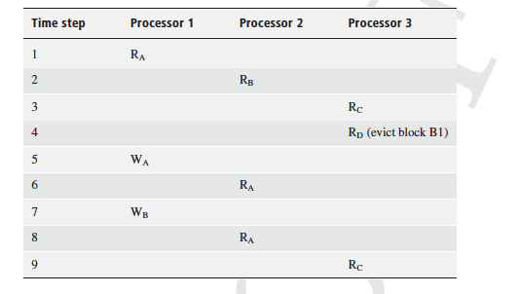
ESSENTIAL VS NON-ESSENTIAL MISSES
EXAMPLE) ASSUME A,B AND C BELONG TO SAME BLOCK (B1) AND D TO ANOTHER
COLD, TRUE AND REPLACEMENT (CONFLICT, CAPACITY) ARE ESSENTIAL WHEREAS FALSE SHARING MISSES ARE NON-ESSENTIAL; CAN BE IGNORED
SAME REASONING CAN BE APPLIED TO MEMORY TRAFFIC
COLD MISS
COLD MISS
COLD MISS
COLD MISS
TRUE SHARING MISS
FALSE SHARING MISS
REPLACEMENT MISS

Slide 35
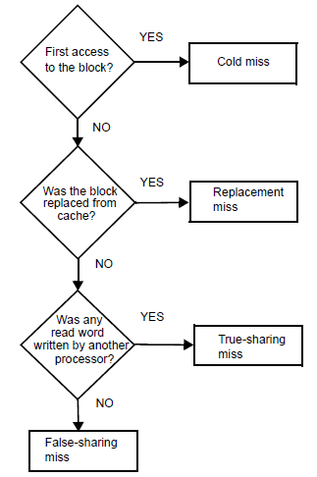
CLASSIFICATION OF MISSES

Slide 36
TRANSLATION LOOKASIDE BUFFER (TLB) CONSISTENCY
RECALL
VIRTUAL MEMORY TYPICALLY MANAGES THE MAIN MEMORY “CACHE” BY MIGRATING FIXED-SIZED MEMORY PAGES BETWEEN MAIN MEMORY AND DISK
PAGE TABLES (STORED IN MAIN MEMORY) KEEP TRACK OF THE MAIN-MEMORY RESIDENT PAGES
A (VIRTUAL) MEMORY ADDRESS IS TRANSLATED TO A (PHYSICAL) MAIN MEMORY ADDRESS. NEEDS HARDWARE SUPPORT!
A TLB IS A CACHE FOR VIRTUAL-TO-PHYSICAL TRANSLATIONS AND TYPICALLY SITS BETWEEN PROC. AND ITS LEVEL 1 CACHE
PAGE TABLE ENTRIES CAN CHANGE ON
PAGE EVICTIONS
ACCESS-RIGHT CHANGES
ACCESS STATS CHANGES (REF BITS, DIRTY BITS)
IN A MULTIPROCESSOR, TLBs ACT AS PRIVATE CACHES
CONSISTENCY BETWEEN TLBS IS ESSENTIAL FOR CORRECTNESS

Slide 37
ENFORCING TLB CONSISTENCY
TLB IS INCONSISTENT WHEN ONE OF ITS ENTRIES IS NOT CONSISTENT WITH THE MASTER COPY – THE PAGE TABLE ENTRY
SOURCES OF INCONSISTENCY
A PAGE IS EVICTED
ACCESS RIGHTS ARE CHANGED
ACCESS STATISTICS IS CHANGED (E.G. PAGE BECOMES DIRTY)
NOT ALL ARE CRITICAL FOR CORRECTNESS
ONE SOLUTION: TLB SHOOTDOWN
ON PAGE EVICTION, MASTER PROC. LOCKS PAGE TABLE ENTRY
MASTER PROC. INTERRUPTS ALL INVOLVED PROCESSORS
EACH PROC. INVALIDATES THE INCONSISTENT TLB ENTRY
EACH PROC. INVALIDATES INCONSISTENT CACHE ENTRIES
EACH PROC. ACKS BACK TO MASTER PROC.
TLB SHOOTDOWN IS AN EXPENSIVE OPERATION; LUCKILY IT HAPPENS RARELY

Slide 38
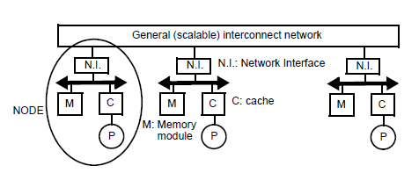
SCALABLE CACHE COHERENCE SOLUTIONS
BUS-BASED MULTIPROCESSORS ARE INHERENTLY NON-SCALABLE
CACHE-COHERENT, NON-UNIFORM MEM. ARCHITECTURES (cc-NUMA):
DISTRIBUTE MAIN MEMORY ACROSS NODES TO LEVERAGE LOCALITY
USE A GENERAL (SCALABLE) INTERCONNECT TO ACCOMMODATE BANDWITH
SNOOPY (BROADCAST) BASED CACHE PROTOCOLS ARE NOT SCALABLE
SCALABLE CACHE PROTOCOLS SHOULD KEEP TRACK OF SHARERS

Slide 39
DIRECTORY-BASED PROTOCOLS

Slide 40
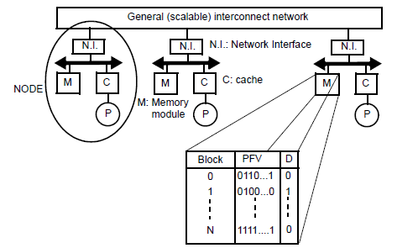
PRESENCE-FLAG VECTOR SCHEME
EXAMPLE)
BLOCK 1 IS CACHED BY PROC. 2 ONLY AND IS DIRTY
BLOCK N IS CACHED BY ALL PROCESSORS AND IS CLEAN
LET’S CONSIDER HOW THE PROTOCOL WORKS

Slide 41
cc-NUMA PROTOCOLS
USE SAME PROTOCOL AS FOR SNOOPING PROTOCOLS (E.G. MSI-INVALIDATE, MSI-UPDATE OR MESI
PROTOCOL AGENTS:
HOME NODE (H): NODE WHERE THE MEMORY BLOCK AND ITS DIRECTORY ENTRY RESIDE
REQUESTER NODE (R): NODE MAKING THE REQUEST
DIRTY NODE (D): NODE HOLDING THE LATEST, MODIFIED COPY
SHARED NODE(S) (S): NODES HOLDING A SHARED COPY
HOME MAY BE THE SAME NODE AS REQUESTER OR DIRTY
NOTE:BUSY BIT PER ENTRY

Slide 42
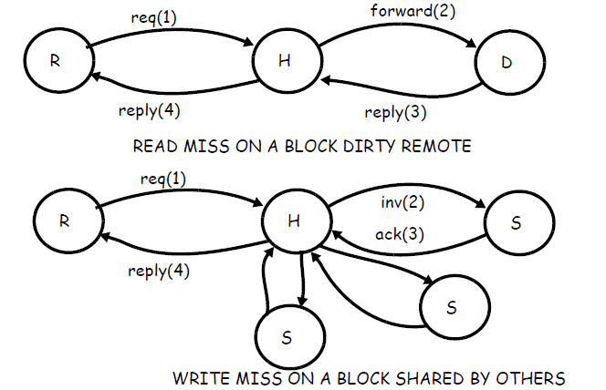
MSI INVALIDATE PROTOCOL IN cc-NUMAs
NOTE: IN MSI-UPDATE THE TRANSITIONS ARE THE SAME EXCEPT THAT UPDATES ARE SENT INSTEAD OF INVALIDATIONS

Slide 43
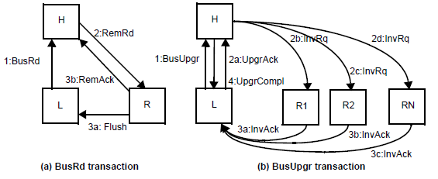
REDUCING LATENCIES IN DIRECTORY PROTOCOLS
BASELINE DIR. PROTOCOL INVOKES FOUR HOPS (IN WORST CASE) ON A REMOTE MISS. OPTIMIZATIONS ARE POSSIBLE
REQUEST IS SENT TO HOME
HOME REDIRECTS THE REQUEST TO REMOTE
REMOTE RESPONDS TO LOCAL
LOCAL NOTIFIES HOME (OFF THE CRITICAL ACCESS PATH)

Slide 44
MEMORY REQUIREMENTS OF DIRECTORY PROTOCOLS
MEMORY REQUIREMENT OF A PRESENCE-FLAG VECTOR PROTOCOL
N PROCESSORS (NODES)
M MEMORY BLOCKS PER NODE
SIZE OF DIRECTORY: M X N²
DIRECTORY SCALES WITH THE SQUARE OF NUMBER OF PROCESSORS; A SCALABILITY CONCERN!
ALTERNATIVES
LIMITED POINTER PROTOCOLS: MAINTAIN i POINTERS (EACH log N BITS) INSTEAD OF N AS IN PRESENCE FLAG VECTORS
MEM. OVERHEAD: SIZE (DIR)/(SIZE(MEMORY) + SIZE(DIR))
EXAMPLE) MEM. OVERHEAD FOR LIMITED POINTER SCHEME:
M x N x i log N /(M x N x B + M x N x i log N) =
i log N / (B + i log N)

Slide 45
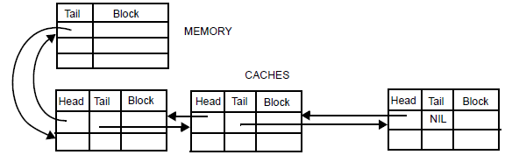
OTHER SCALABLE PROTOCOLS
COARSE VECTOR SCHEME
PRESENCE FLAGS IDENTIFY GROUPS RATHER THAN INDIVIDUAL NODES
DIRECTORY CACHE
DIRECTORY OVERHEAD IS PROPORTIONAL TO DIR. CACHE SIZE INSTEAD OF MAIN MEMORY SIZE (LEVERAGING LOCALITY)
CACHE-CENTRIC SCHEMES. MAKE OVERHEAD PROPORTIONAL TO (PRIVATE) CACHE SIZE INSTEAD OF MEMORY
EXAMPLE) SCALABLE COHERENT INTERFACE

Slide 46
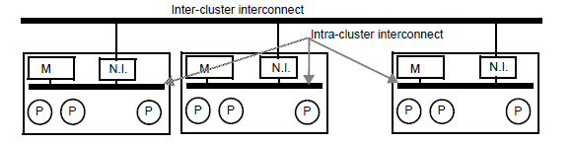
HIERARCHICAL SYSTEMS
INSTEAD OF SCALING IN A FLAT CONFIG. WE CAN FORM CLUSTERS IN A HIERARCHICAL ORGANIZATION
RELEVANT INSIDE AS WELL AS ACROSS CHIP-MULTIPROCESSORS
COHERENCE OPTIONS:
INTRA-CLUSTER COHERENCE: SNOOPY/DIRECTORY
INTER-CLUSTER COHERENCE: SNOOPY/DIRECTORY
TRADEOFFS AFFECT MEMORY OVERHEAD AND PERFORMANCE TO MAINTAIN COHERENCE

